Slide 1
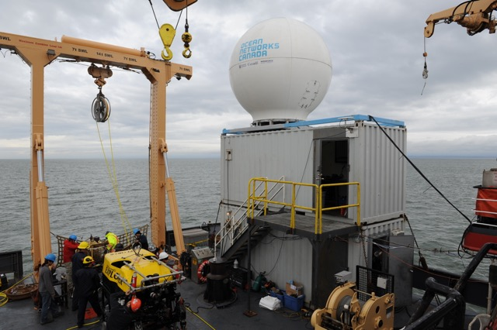
Ocean Networks Canada
Seatel 9711-88 Satellite System

Slide 2
Seatel 9711-88 VSAT Specifications
2.4m Dish
3.66m Radome
3-axis: azimuth, elevation, and cross level
1U rackmount Media Xchange Point (MXP) controller
120VAC Dish Power / 240VAC Air Conditioner Power
Weight = 430Kg (950lbs) (Radome/Dish/Pedestal)
Transmit/Receive - LMR400 coaxial cable ­
Seamless software transition from C band to Ku-band feeds
ONC received first model of this system in 2014.

Slide 3
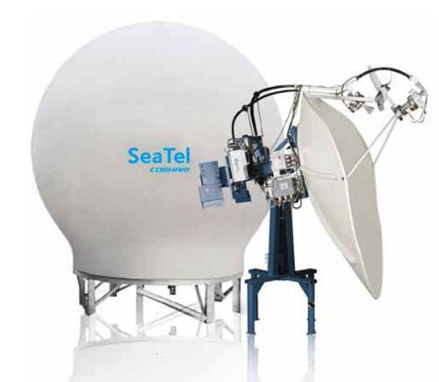
Seatel 9711-88 Diagram

Slide 4
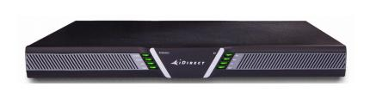
Verizon iDirect Satellite Service
IP based satellite communication system
Base Rate/Year: $2250.00 USD (3000.00 CAD) Annually
Upgraded bandwidth Rate/Month: $2374.00 USD ($3120.00 CAD)
Shore to ship (Internet) = 2 mbps (megabits per second)
Normal browsing internet speed
Ship to shore = 3 mbps (megabits per second)
Supplies one high definition video stream to shore or two lower resolution video streams
X7 iDirect Modem (x2) = $2378.00 USD (Already purchased)

Slide 5
Seatel Maintenance
ONC has put on roughly 3 months of usage with the Seatel 9711-88 satellite system over a 2 year period.
Currently there has not been any incurred maintenance costs to date.
Spares kit has been purchased = $43860.00 (USD)
Spares kit includes:
Comtech SSPA: $33150.00 (USD)
Replacement motors for all axis: $9750.00
Quad low-noise block downconverter (LNB): $960.00 (USD)

Slide 6
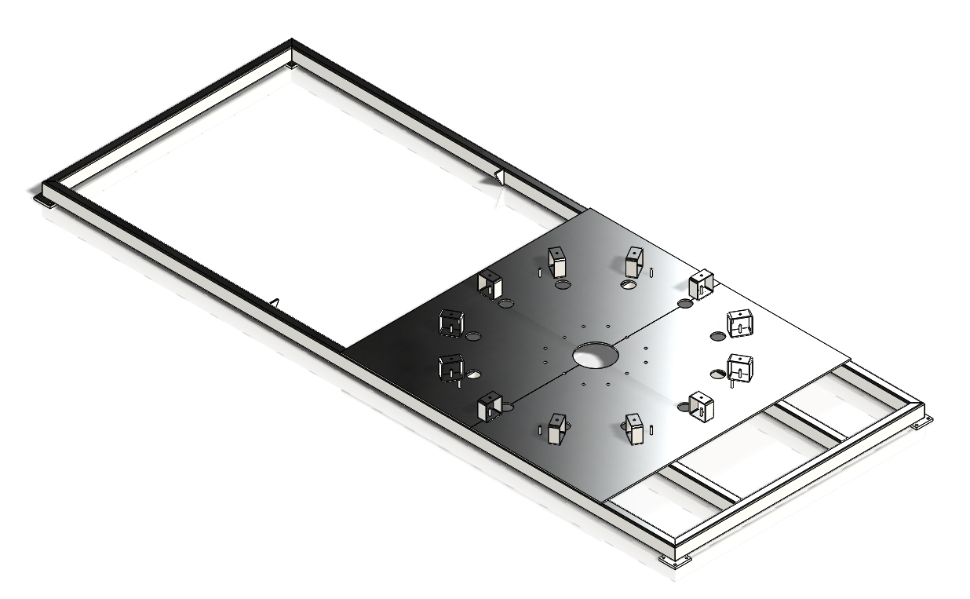
ONC Container Mount
Mounts directly on top of a double 40ft container stack
Weight: 3800 lbs
Cost: $4500 CAD

Slide 7
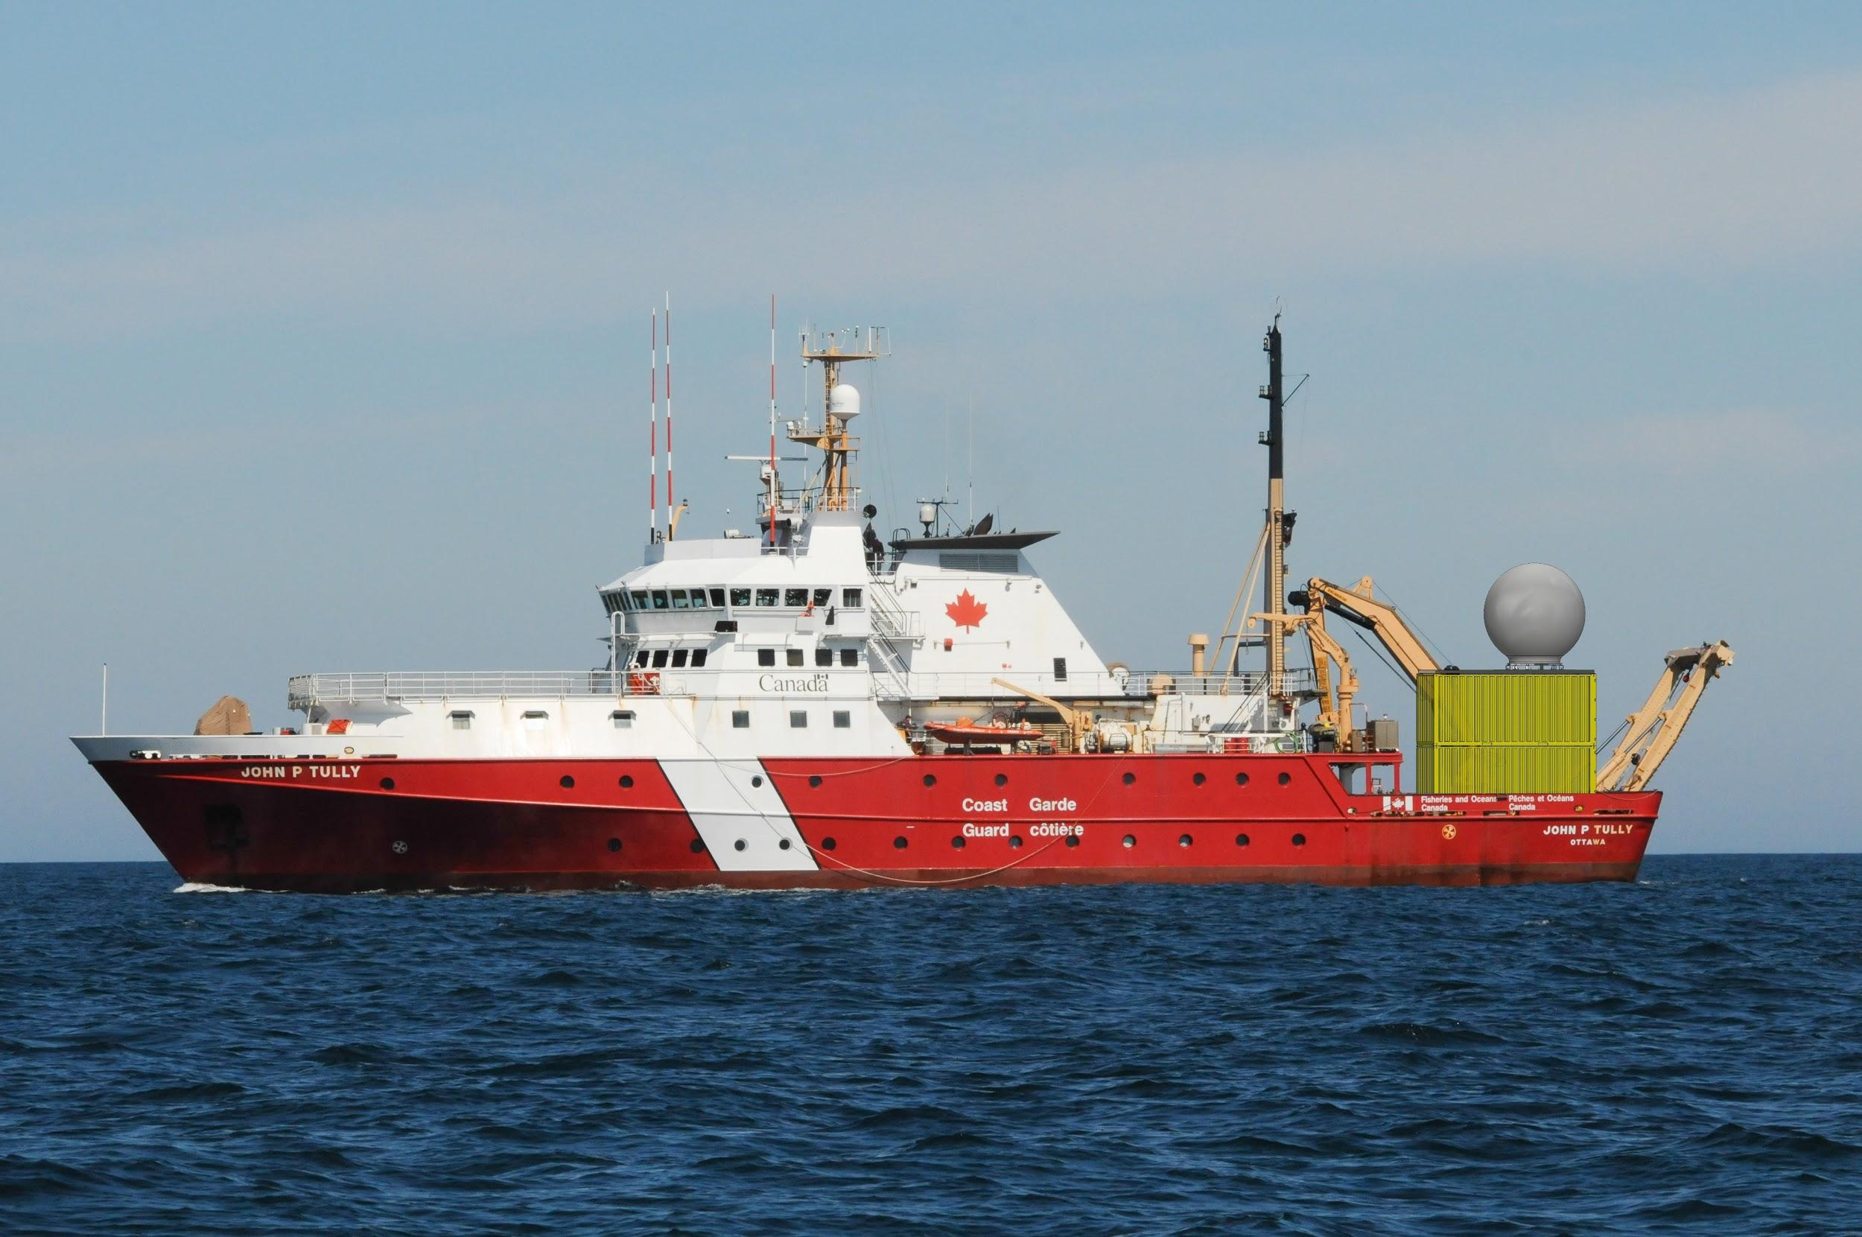
http://www.idirect.net/Products/iDirect-Evolution.aspx
http://www.cobham.com/communications-and-connectivity/satcom/satellite-communication-at-sea/c-band-maritime-vsat/sea-tel-9711-ima-with-cku-switchable-feeds/

